Slide 1
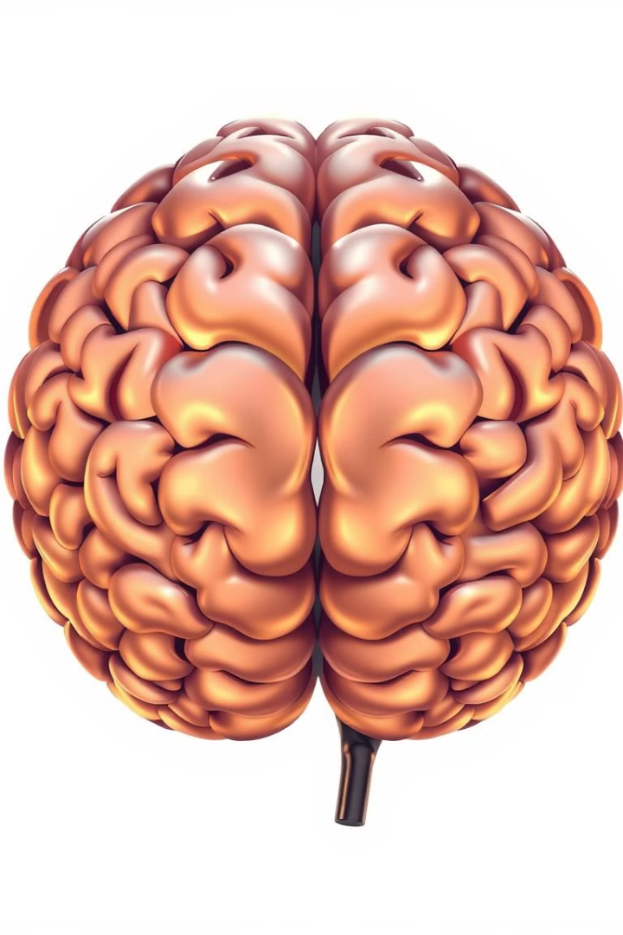
Understanding Mental Health Data Analysis
Welcome to this step-by-step guide on leveraging AI for mental health insights. We'll cover data processing, visualization, and AI modeling using Python. This presentation provides a practical approach to identifying mental health risks early, enabling timely intervention.
Ms. Nitya Kasarla
Ms. shruti Pawal
Mr. Sabmit Waghmare

Slide 2

1. Importing Libraries
We begin by importing essential Python libraries. Pandas and NumPy are used for data manipulation.
Seaborn and Matplotlib enable data visualization. Scikit-learn provides AI modeling tools.

Slide 3

2. Setting Working Directory
1
Directory Selection
2
File Access
Set the working directory to specify the location of data files.
This step is crucial for Python to locate and access the necessary data.
3
Organization
Think of it as opening a specific drawer in a filing cabinet.

Slide 4
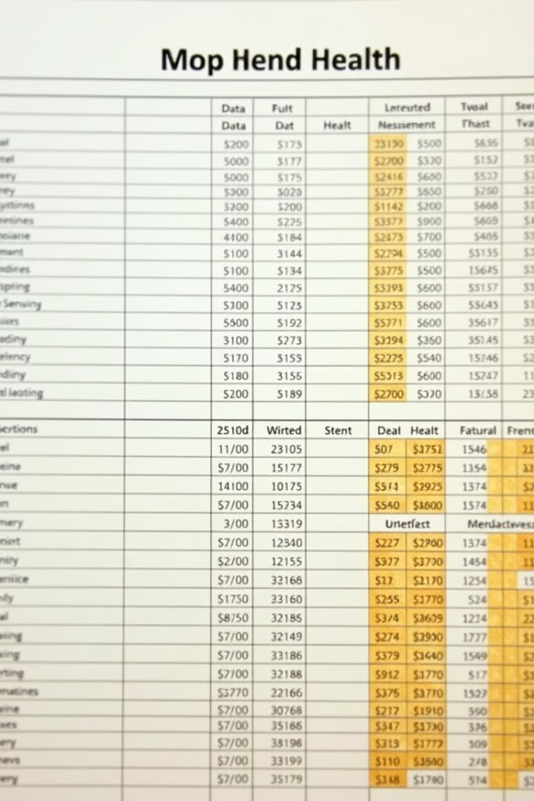
3. Loading Data
Excel File
Dataframe
Load the mental health dataset from an Excel file using pandas.
The data is read into a pandas DataFrame for easy manipulation.
Backup
Create a backup of the DataFrame to prevent accidental modifications.

Slide 5




4. Cleaning Missing Data
Address missing values to ensure data integrity and quality.
Fill missing text fields using the mode (most frequent value).
Fill missing numerical fields, like age, using the mean (average value).

Slide 6
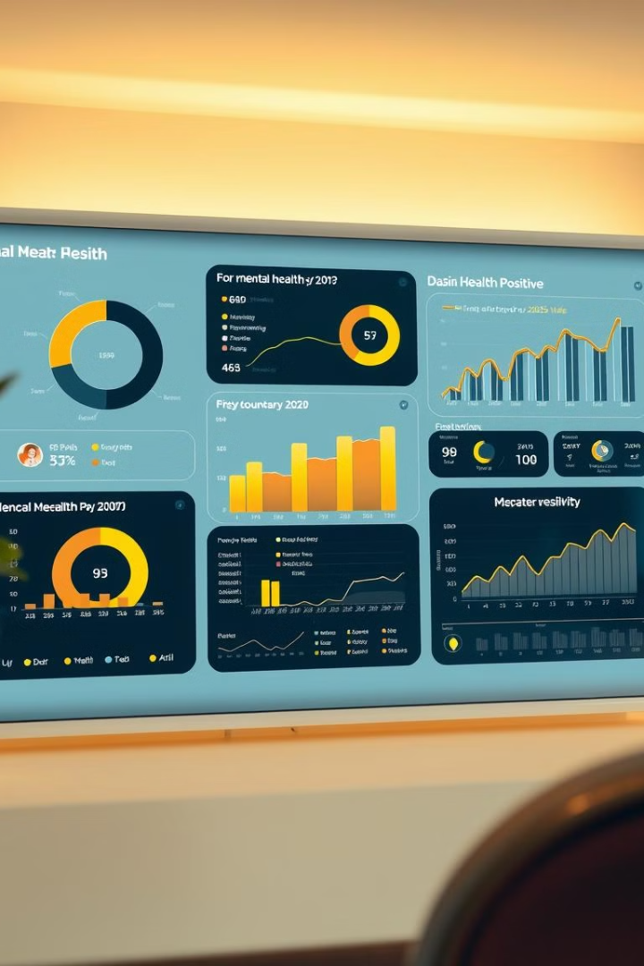



5. Data Visualization
Pie Charts
Use pie charts to illustrate risk distribution among participants.
Bar Charts
Utilize bar charts to show trends in social media usage.
Heatmaps
Employ heatmaps to visualize correlations between different features.

Slide 7

6. Creating Target Variable
1
Emotional Scores
Categorize participants based on their emotional well-being scores.
2
High Risk (1)
Assign '1' to individuals identified as high risk.
3
Low Risk (0)
Assign '0' to individuals identified as low risk.

Slide 8



7. Feature Engineering & Preprocessing
Encoding
2
One-hot encode categorical features for AI model compatibility.
Scaling
1
Scale numerical features for better AI model performance.
Transformation
Prepare the data to ensure it is ready for AI modeling.
3

Slide 9
8. Building & Evaluating AI Model
1
Train
2
Predict
3
Evaluate
Train a Random Forest classifier to predict mental health risk. Evaluate using accuracy, ROC AUC, and confusion matrices.

Slide 10

9. Conclusion & Applications
90%
Early
Accuracy
Detection
Achieved in predicting mental health risk.
Identify at-risk individuals early.
Timely
Intervention
Enable timely and effective intervention.
AI-based approaches offer a powerful tool for early identification of mental health risks. This enables the provision of timely interventions and support.

Slide 11
conclusion
In conclusion, social media provides a rich source of mental health insights. By leveraging machine learning, we can detect early warning signs and enable timely intervention. However, responsible AI practices must be adopted to ensure ethical implementation. This project highlights the potential of data science in promoting mental well-being.

Slide 12
Thank you for your attention! I’d be happy to answer any questions you may have.

Slide 13
References
DeepSeek. (n.d.). Retrieved from https://deepseek.com
Perplexity AI. (n.d.). Retrieved from https://www.perplexity.ai
Google. (n.d.). Retrieved from https://www.google.com
OpenAI. (2024). ChatGPT. Retrieved from https://openai.com/chatgpt
Blackbox AI. (n.d.). Retrieved from https://www.blackbox.ai
Quadratic. (n.d.). Retrieved from https://www.quadratic.com
Kaggle. (n.d.). Retrieved from https://www.kaggle.com
Gamma. (n.d.). Retrieved from https://gamma.app
Art. (n.d.). Retrieved from https://www.imagine.art
Meta AI. (n.d.). Retrieved from https://ai.meta.com

